Slide 1
Term 3 Week 3 Lesson 3 notes
Dilutions

Slide 2
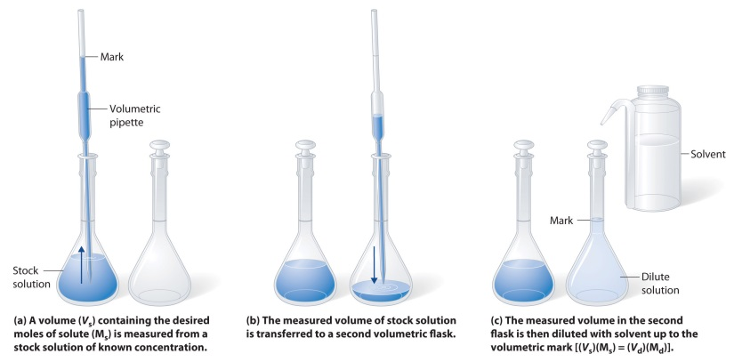
The process of adding water to a solution to make it less concentrated is called dilution.
Dilution is an important laboratory technique used to produce solutions of required concentration for testing and analysis procedures. The dilution process must be as accurate possible, so the concentration of the required diluted solution is correct.

Slide 3
The dilution procedure involves:
1. using a pipette to measure a definite volume of a solution of known concentration
2. transferring this volume to a volumetric flask
3. adding sufficient water to the volumetric flask to make up the solution to the calibration mark.

Slide 4
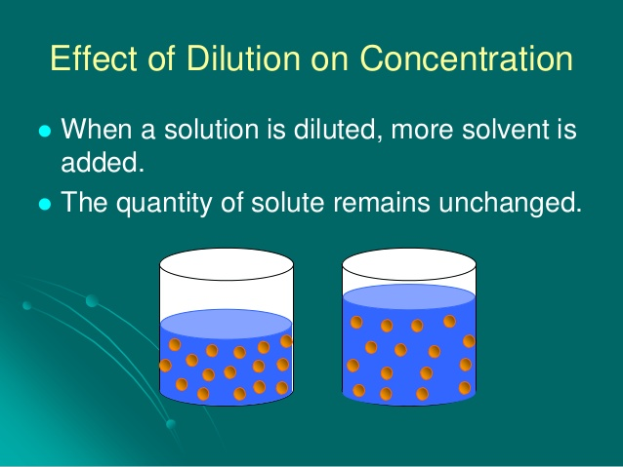

Slide 5
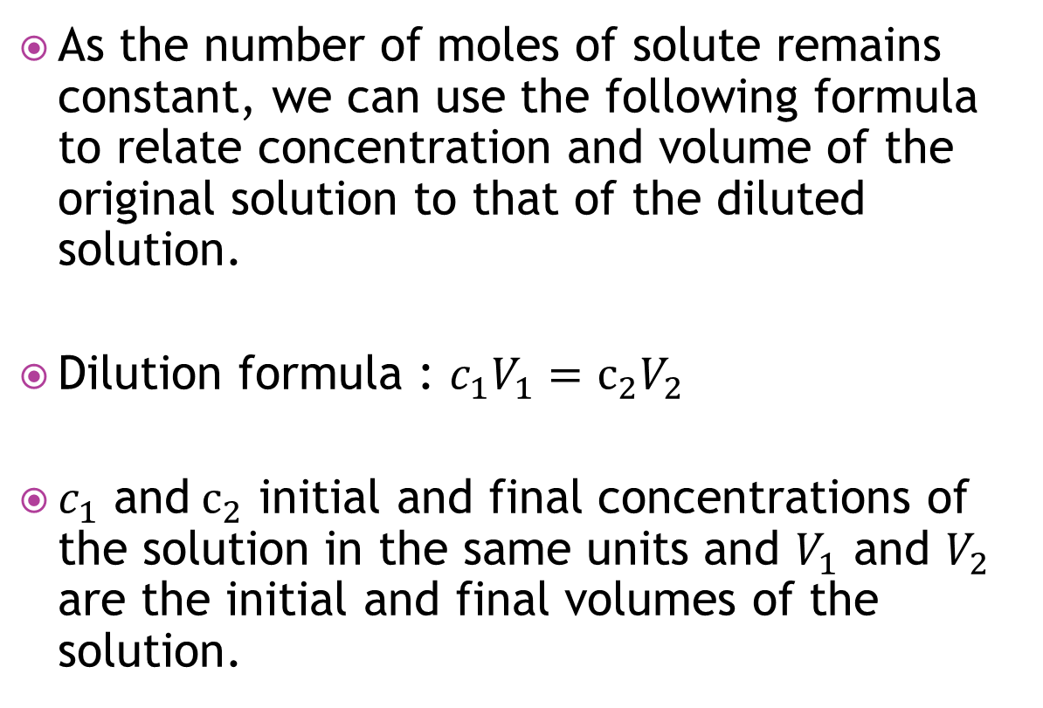
As the number of moles of solute remains constant, we can use the following formula to relate concentration and volume of the original solution to that of the diluted solution.
Dilution formula : $c_{1}V_{1}=c_{2}V_{2}$
$c_{1}$ and${ c}_{2}$ initial and final concentrations of the solution in the same units and $V_{1}$ and $V_{2}$ are the initial and final volumes of the solution.

Slide 6
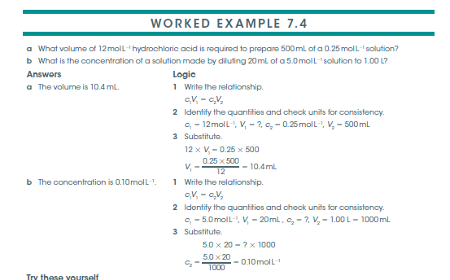
See the worked example: 7.4 in page: 318 NC

